Slide 1

Lec-01-2 Linux Commands
Dr Syed Faisal Hasan and Dr. Hymie Latif
Computing and Information Technology
College of Enterprise and Development
Otago Polytechnic
Dunedin, New Zealand
Bachelor of Information Technology
IN616 – Operating Systems Concepts
Semester 1, 2020

Slide 2
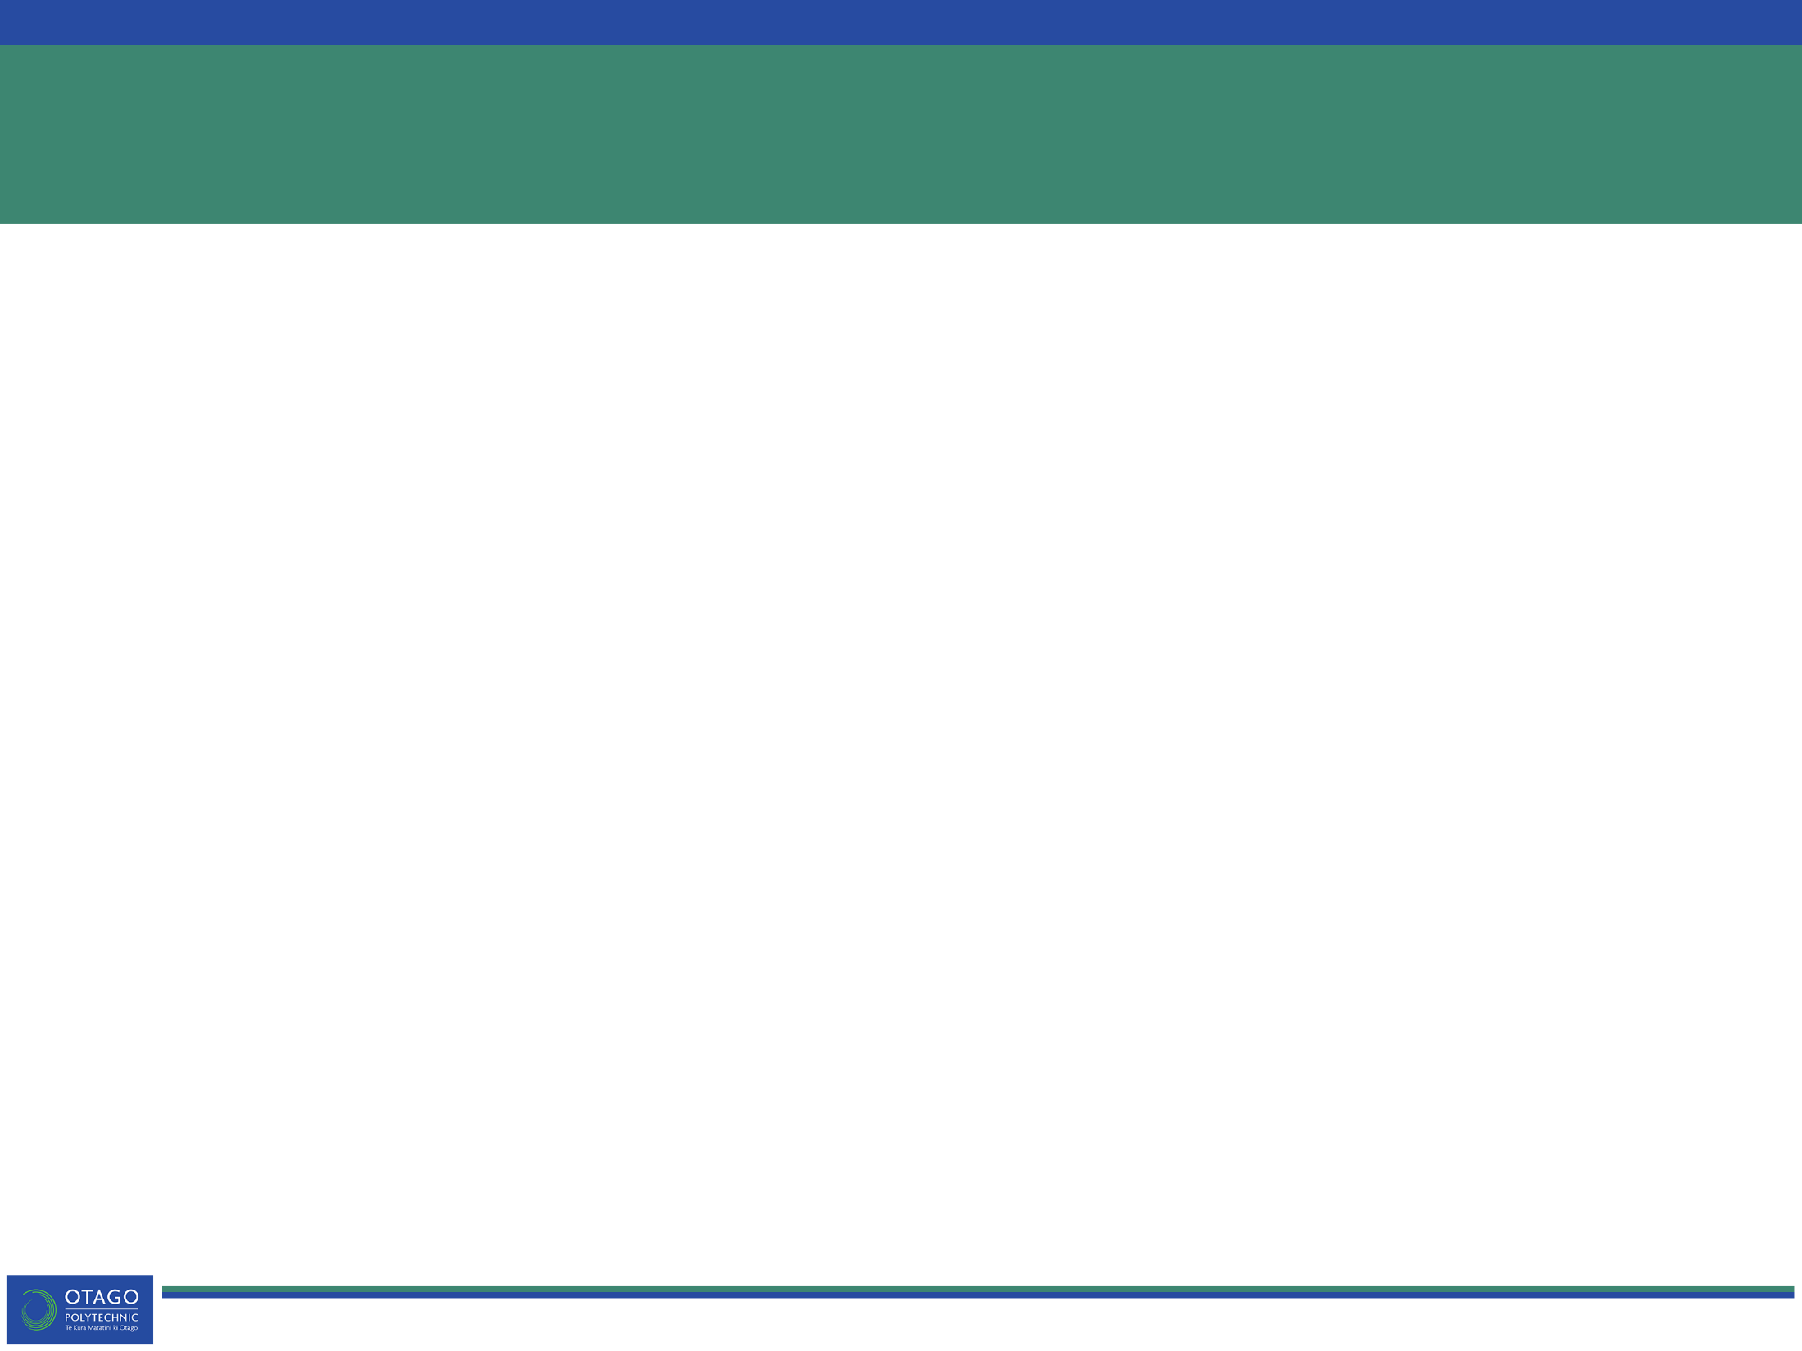
Schedule
Recap
History
BASH, Shells, Terminals
Linux commands
Linux file system structure
Linux help system
Metacharacters
Environment variables
User privilege

Slide 3
Linux: Market Share
Mobile:
Android with 71%
iOS is 26%
Desktop:
Linux with 1.6%
Windows is 89% and Mac is 9.5%
www.netmarketshare.com
Web servers
Linus accounts for 36% of all webservers
http://stackoverflow.com/research/developer-survey-2016#technology-desktop-operating-system
All UNIX-like account for 67% of all webservers
http://w3techs.com/technologies/overview/operating_system/all
Supercomputers:
Linux with 99.4%
http://www.top500.org/statistics/overtime

Slide 4
Why is Linux not Popular in Desktop?
Technical challenges
Let’s hear what Linus says https://www.youtube.com/watch?v=ZPUk1yNVeEI
Other Challenges
Business
Applications
Service Level Agreements

Slide 5
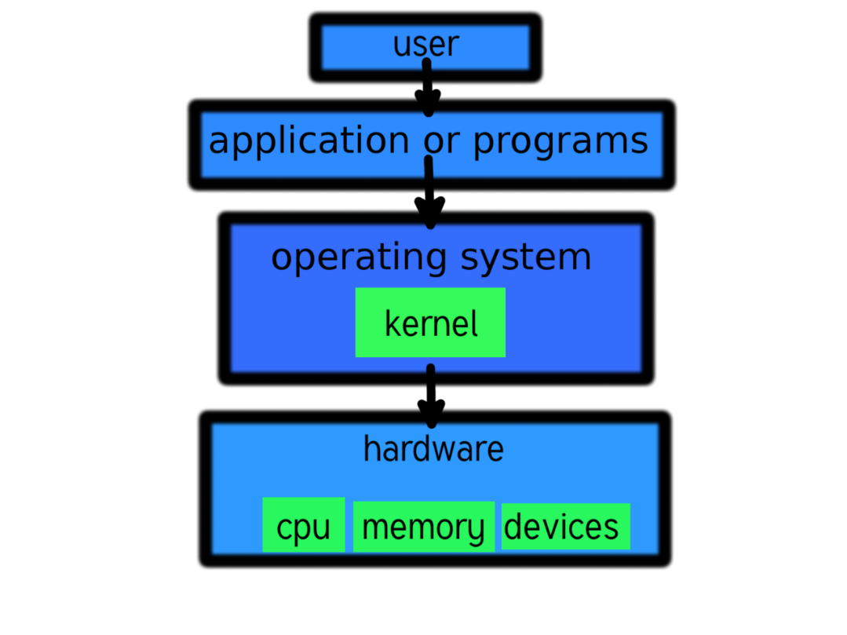
Linux: Kernel or OS or Distribution
Linux
Only kernel without software ecosystem
Core functionality:
Architecture dependent code (32/64-bit)
Interface for drivers (not actual drivers)
System call hooks for applications
Task scheduling
Memory management
Network functionality
Notes:
Kernel: only core functionality: architecture-dependent code, Interface for drivers (not drivers themselves!) and system call hooks for applications (but not system call interface, applications or tools (e.g. shell) themselves), task scheduling, memory management, networking functionality. Kernel does not include even shell etc.
All Linux distributions includes
GUI system +
GNU utilities (such as cp, mv, ls, date, bash etc) +
installation & management tools +
GNU c/c++ Compilers +
Editors (vi) +
and various applications (such as OpenOffice, Firefox)
Name some distros? Slackware, Gentoo, ArchLinux, AlpineLinux, Ubuntu, Android

Slide 6

Linux: Kernel or OS or Distribution
Distribution
Linux Kernel + GNU Utilities (cp, mv, ls, bash) + code compilers + editors + applications
Focuses on purpose of distribution
www.distrowatch.com
Notes:
Kernel: only core functionality: architecture-dependent code, Interface for drivers (not drivers themselves!) and system call hooks for applications (but not system call interface, applications or tools (e.g. shell) themselves), task scheduling, memory management, networking functionality. Kernel does not include even shell etc.
All Linux distributions includes
GUI system +
GNU utilities (such as cp, mv, ls, date, bash etc) +
installation & management tools +
GNU c/c++ Compilers +
Editors (vi) +
and various applications (such as OpenOffice, Firefox)
Name some distros? Slackware, Gentoo, ArchLinux, AlpineLinux, Ubuntu, Android

Slide 7
TOPIC: History f

Slide 8
From UNICS (UNIX) to Linux
AT&T developed UNIX in 1969
1970s
Ken Thompson & Dennis Ritchie (inventors of C) joined the development of UNICS
UNICS = Uniplexed Information and Computing System
UNICS was later known as UNIX
Objectives
Portability
Separation of hardware and software
Developed in C with minimal amount of machine code
Higher efficiency
Limiting memory consumption of OS itself
Short commands: ls, man, cp, mv, etc.
Split into two branches:
System 5 (AT&T and others) → commercial
Berkeley Software Distribution (BSD) (University of California) → academic

Slide 9
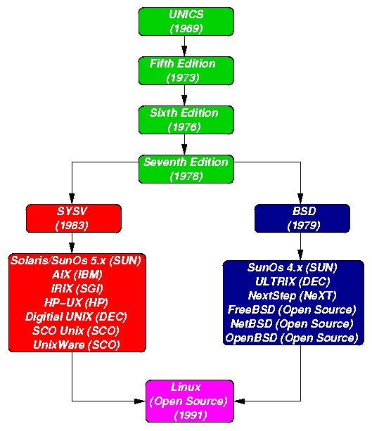
From UNICS (UNIX) to Linux
Notes:
http://www.doc.ic.ac.uk/~wjk/UnixIntro/Lecture1.html

Slide 10
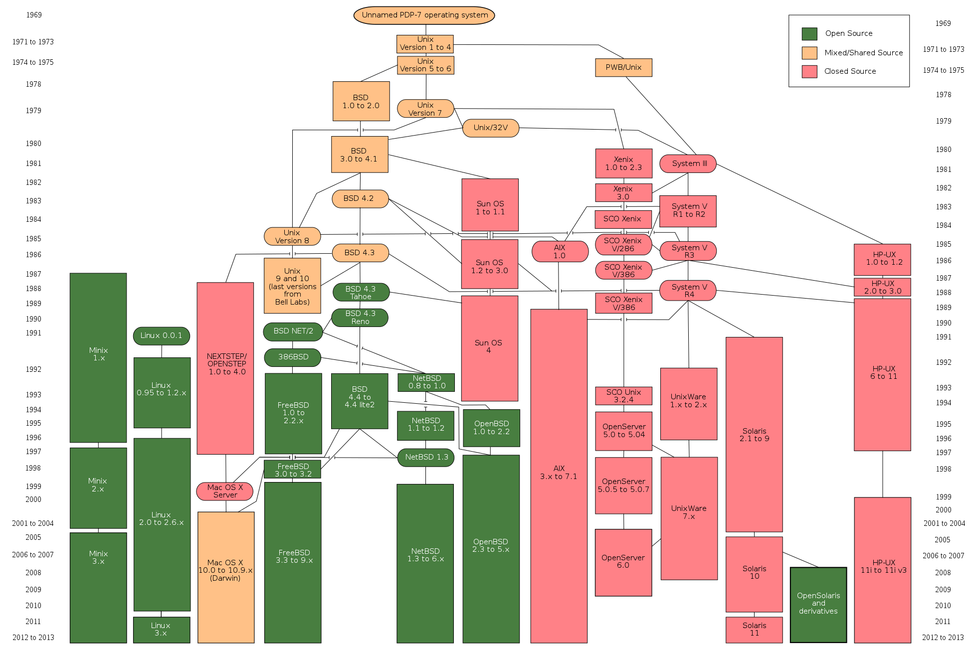
From UNICS (UNIX) to Linux
Notes:
https://en.wikipedia.org/wiki/File:Unix_history-simple.svg

Slide 11
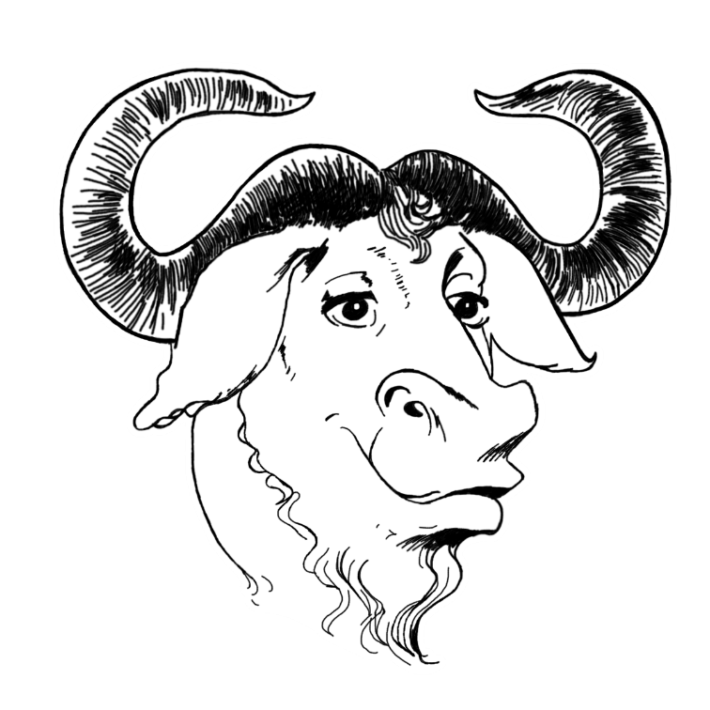
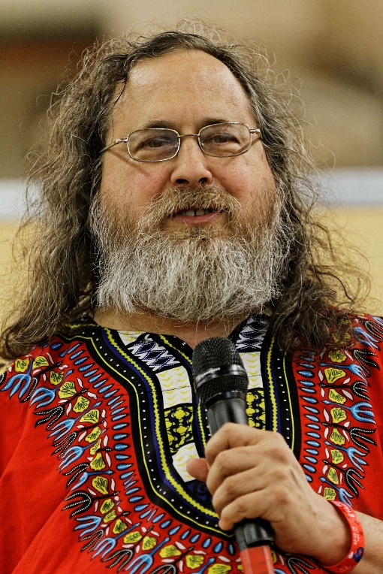
Linux: And GNU project
GNU: GNU’s not UNIX
Richard Stallman
Has promoted open source software since 1984
Founder of GNU Foundation
The author of the GNU General Public License (GPL)
Creator of Emacs
GNU Project
Collection of open source UNIX-compatible software
User-level applications
http://gnu.uberglobalmirror.com/
https://en.wikipedia.org/wiki/List_of_GNU_packages
Torvalds adopted GPL in 1992 – Linux was de facto GNU kernel
Notes:
GNU: recursive acronym
Stallman: Researcher turned activist
Hacking passcode system at MIT
Living in university
GNU Hurd: Micro kernel based on MACH kernel (Carnegie Mellon, used by Mac OS X)
Name: It's time [to] explain the meaning of "Hurd". "Hurd" stands for "Hird of Unix-Replacing Daemons". And, then, "Hird" stands for "Hurd of Interfaces Representing Depth". We have here, to my knowledge, the first software to be named by a pair of mutually recursive acronyms. (https://en.wikipedia.org/wiki/GNU_Hurd)
To clarify what a ‘kernel’ is, we need to have a look

Slide 12
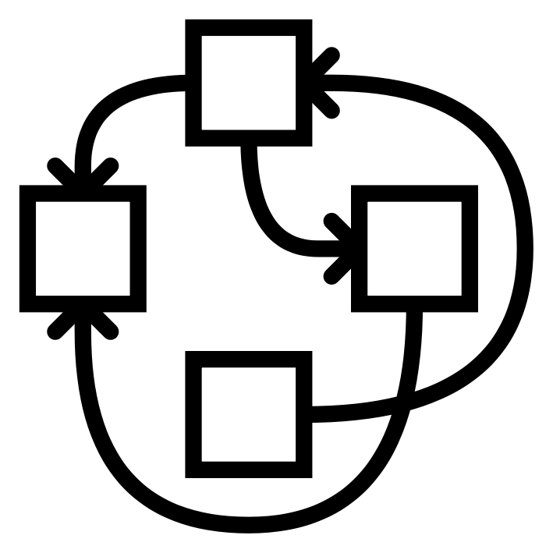
Linux: And GNU project
GNU is missing a kernel !!
GNU Hurd
Been under development since 1990
Designed to be a replacement for the UNIX kernel
Linux + GNU
Most Linux distributions use GNU coreutils
Commonly known as GNU/Linux
http://gnu.uberglobalmirror.com/
https://en.wikipedia.org/wiki/List_of_GNU_packages

Slide 13
TOPIC: Introduction to BASH f

Slide 14


Shells ???
Shell
User interface
Provides ability to interact with Linux kernel
Provides a command line interface
BASH
A type of shell
Bourne Again SHell
No… not that dude →

Slide 15

BASH
Default shell used in most Linux systems
Different users can have different shells
By installing/specifying multiple shells
Same user can have multiple shells
By logging on multiple times

Slide 16
Other Shells ???
Alternative shells?
Tcsh
Sch
Ksh
Zsh
Fish
Short overview of other shells
https://www.tecmint.com/different-types-of-linux-shells/

Slide 17

Terminals
Device which user connects to the shell
Can be local
We can use multiple local at the same time
Alt + F1 → tty1
Alt + F2 → tty2
… (F1 → F6)
Alt + F7 → tty7 (this is the GUI – but we do not have one ☹)
Can be remote – anyone know how?
Notes:
Alt + F7 therefore shows the bootlog
tty: teletypewriter

Slide 18
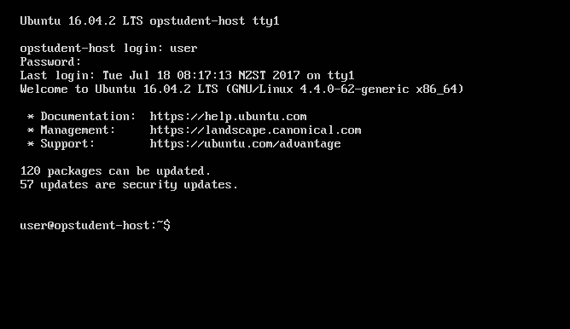
Terminals

Slide 19
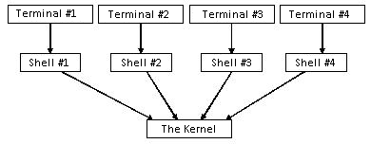
Terminals

Slide 20
Quick Summary
Shell
Another word for a User Interface of an operating system
It is software-based
BASH
A particular type of command line shell
Terminal
Text-based input/output environment
Technically a device, but can be software
Also can be emulated
Notes:
PuTTY (/ˈpʌti/) is a free and open-source terminal emulator,

Slide 21

Terminal Structure
Format: username@hostname:directory$
username = user
hostname = opstudent-host
Present working directory: ~ (home dir)
$ at end → normal user account
# at end → super user account (not seen much)

Slide 22


Summarise these:
Username?
Hostname?
Working directory?
Privilege?
Notes:
user = root
hostname = opstudent-host
pwd = /etc/network

Slide 23
TOPIC: Linux Commands f

Slide 24
Commands
Generic command syntax:
<command> <options> <arguments>
Options are not mandatory
Arguments are not mandatory
Examples:
ls
ifconfig
pwd
hostname
cat

Slide 25
Commands (ls): Options
Generic command syntax:
<command> <options> <arguments>
Options modify command behavior
Prefixed with a dash symbol: -
For example: -i
Full-word options with double dash: --
For example: --inode
Examples:
ls -i
ls --inode

Slide 26
Commands (ls): Arguments
Generic command syntax:
<command> <options> <arguments>
Arguments are input to command
No argument lists current working directory:
ls
Supplied argument lists specified directory:
ls /etc
What arguments do depend on the command

Slide 27
Commands (ls): Full example
Generic command syntax:
<command> <options> <arguments>
Examples:
ls –i /etc/ssh/
ls --inode /etc/ssh/

Slide 28
Command Examples
ls –l /home/user
List files in home directory for user account
cat file.txt
Display file.txt on standard output
mkdir -p sales/june
Make a directory (june) and parent directory (sales)
touch tuesday.log
Create file/update timestamp on file
clear
Clear the screen (standard output)

Slide 29
File System Hierarchy Principles
Difference to Microsoft Windows?
There is no C:\
Instead, Linux has a single root directory → /
/ == C:\
Linux file systems
Tree structure (like all file systems)
Top level directories have a specific purpose
Relatively consistent across all Linux distributions

Slide 30
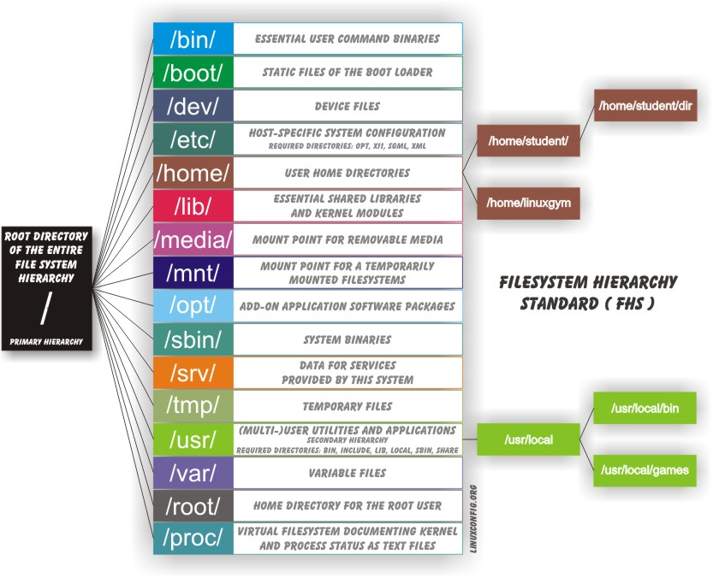
Linux File System

Slide 31
Linux File System: Resources
Good Introduction to File System Hierarchy in Linux:
Linux compared to Windows
http://codeidol.com/community/nix/understanding-the-linux-file-system/5302/
Full specification reference:
Food to find out purpose of specific directories
http://refspecs.linuxfoundation.org/FHS_3.0/fhs/index.html

Slide 32
Absolute VS Relative paths
Absolute:
Always starts at the root directory
C:\Users\student\Desktop\notes.txt
/home/student/Desktop/notes.txt
Relative:
The path that is relative to the current directory
If we are in C:\Programs Files
And want to access C:\Users\student\Desktop\notes.txt
..\Users\Tom\Desktop\notes.txt

Slide 33
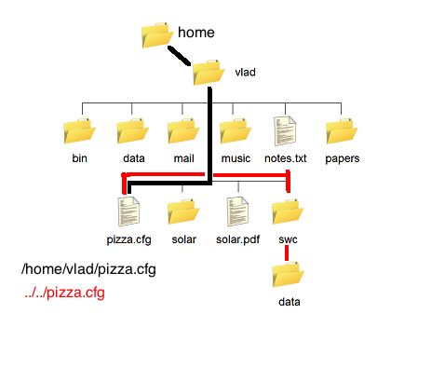
Absolute VS Relative paths
Current working directory: /home/vlad/swc/data
From current directory…
How do we get to pizza.cgf?

Slide 34
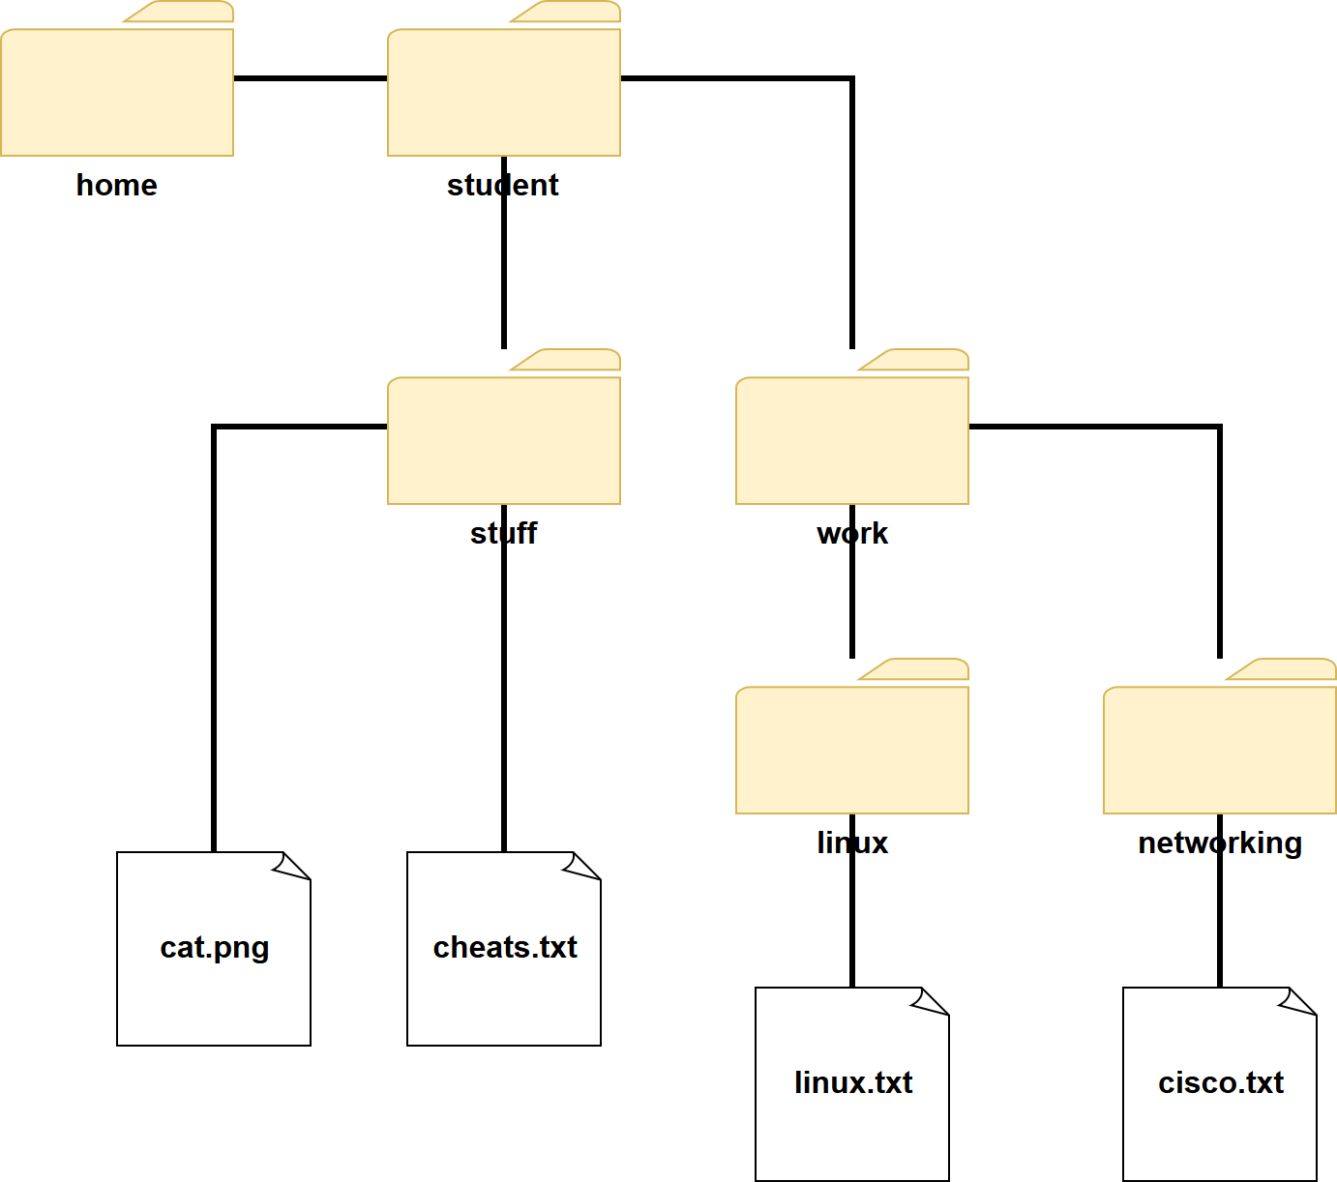
Absolute VS Relative Paths
Current working directory: /home/student/work/linux
From current directory…
How do we get to networking?
../networking
/home/student/work/networking

Slide 35
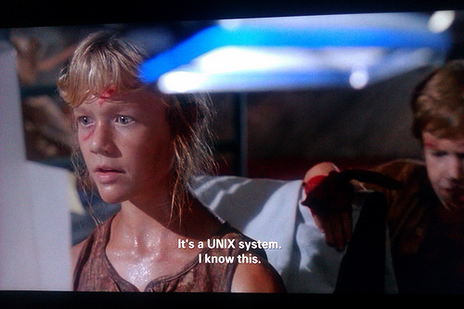
Linux Help System

Slide 36
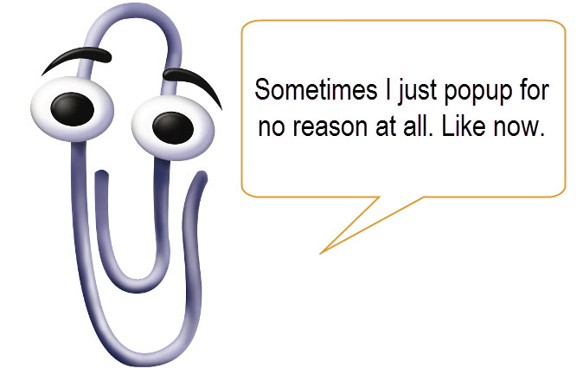
Linux Help System
It is built into the machine (or online)
man <command>
man stands for manual
It is the system manual for command
Type q to exit the manual
<command> --help
Not always consistent
Provides overview of arguments
ls --help
Encoded in program itself
You can also check manpages online: http://manpages.ubuntu.com/

Slide 37
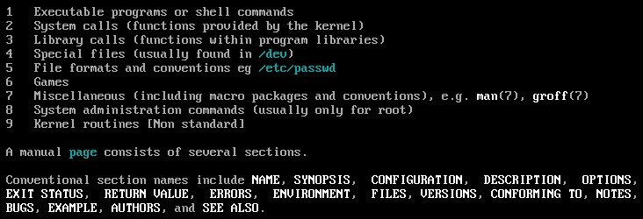
Man: organised by sections
Output of: man man
man ls

Slide 38
Home work: Realize Setup
vRealize setup: https://fthvra01.op.ac.nz/vcac/
Check you have access (can log in)
Request the TrainingVM
Catalog → IN616 TrainingVM (Request one!)

Slide 39
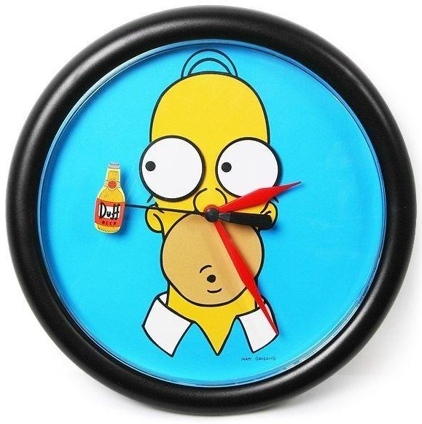
Lab_01_2 – Start
TOPICS:
Browsing the Linux file system
Using Bash commands
Using the help system
Complete up to section 4
We will discuss more, before the next lab sections

Slide 40
Metacharacters
Special characters used in commands
They have special meanings
$ in BASH denotes a variable
$name
$age
In this context, $ is a metacharacter
Avoid metacharacters in command line arguments!

Slide 41
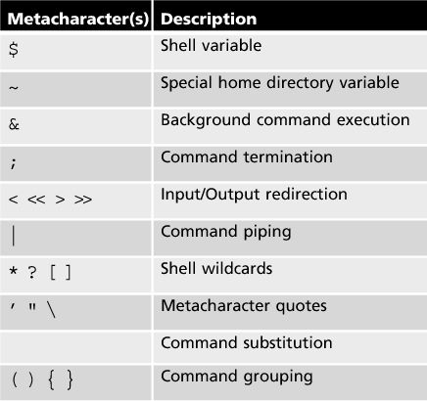
Metacharacters
http://faculty.salina.k-state.edu/tim/unix_sg/shell/metachar.html
http://tldp.org/LDP/GNU-Linux-Tools-Summary/html/x11655.htm
Notes:
? Is a single character
* Can mean any number of characters
[] square brackets specifies a range:
m[a,o,u]m → mam, mom, mum
{} curly braces are a list
\ escape , e.g., \\ for a backslash

Slide 42
Environment variables
We can display variables using
echo $var
echo $name
Run env to show all environment variables
Add you own variables into .bashrc
Command | Meaning
$SHELL | Shell binary used in current terminal
$PATH | Path variable contains locations for commands
$HISTSIZE | Size of history
$TERM | Returns terminal type (limited use nowadays)

Slide 43
Using metacharacters (if you have to)
Prevent interpretation of metacharacters
Single quotes: ‘’
Double quotes: “”
Try difference between
echo ‘The price is $100’
echo “The price is $100”
Double quotes preserve: $, \, ‘
Enforce interpretation of command (command substitution):
Backtick or grave: `
echo The date is `date`

Slide 44

Superuser, su, root
In Linux, superuser has:
Privilege to receive all privilege
insert metaphor →
Doesn’t mean the account has all privilege
You need superuser privilege to access specific folders/files
Rules:
Everyone has a normal, non-superuser account
Only elevates privilege when required (prompted)

Slide 45
Elevating privilege
In Ubuntu, login as root is disabled (by default)
Elevation of account is also usually disabled (su root)
Instead use sudo
user must be part of sudo group
Approach 1: sudo <command>
Run command with su privilege
Will ask you for password (user password, not root password)
Approach 2: sudo !!
Runs previous command with su privilege
Convenient, no need to re-run command

